Slide 1



Sprint 2 Review 07/August-18/Augut
Continental
August 2023

Slide 2
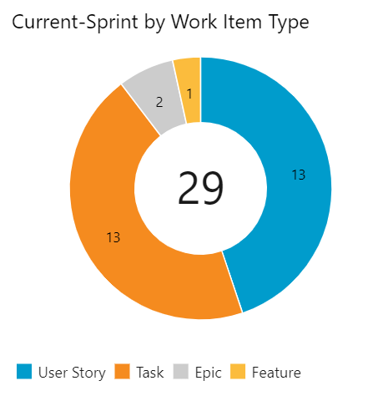

Slide 3
Thank you
Demo - Q&A
Cloud Services
MJV
Full Stack
Smit & Joe
Decision Science
Yang & Nicki

Slide 4
DS Demo

Slide 5
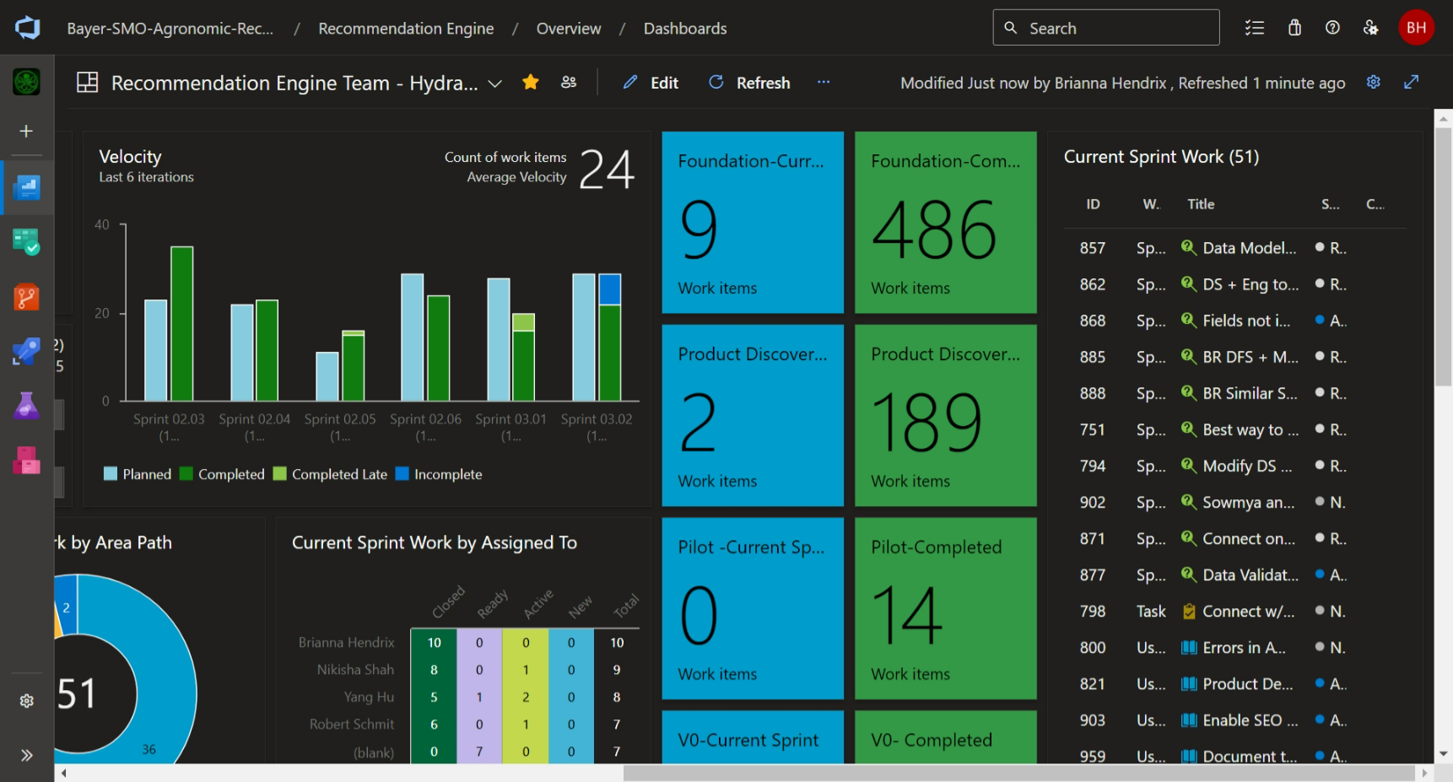
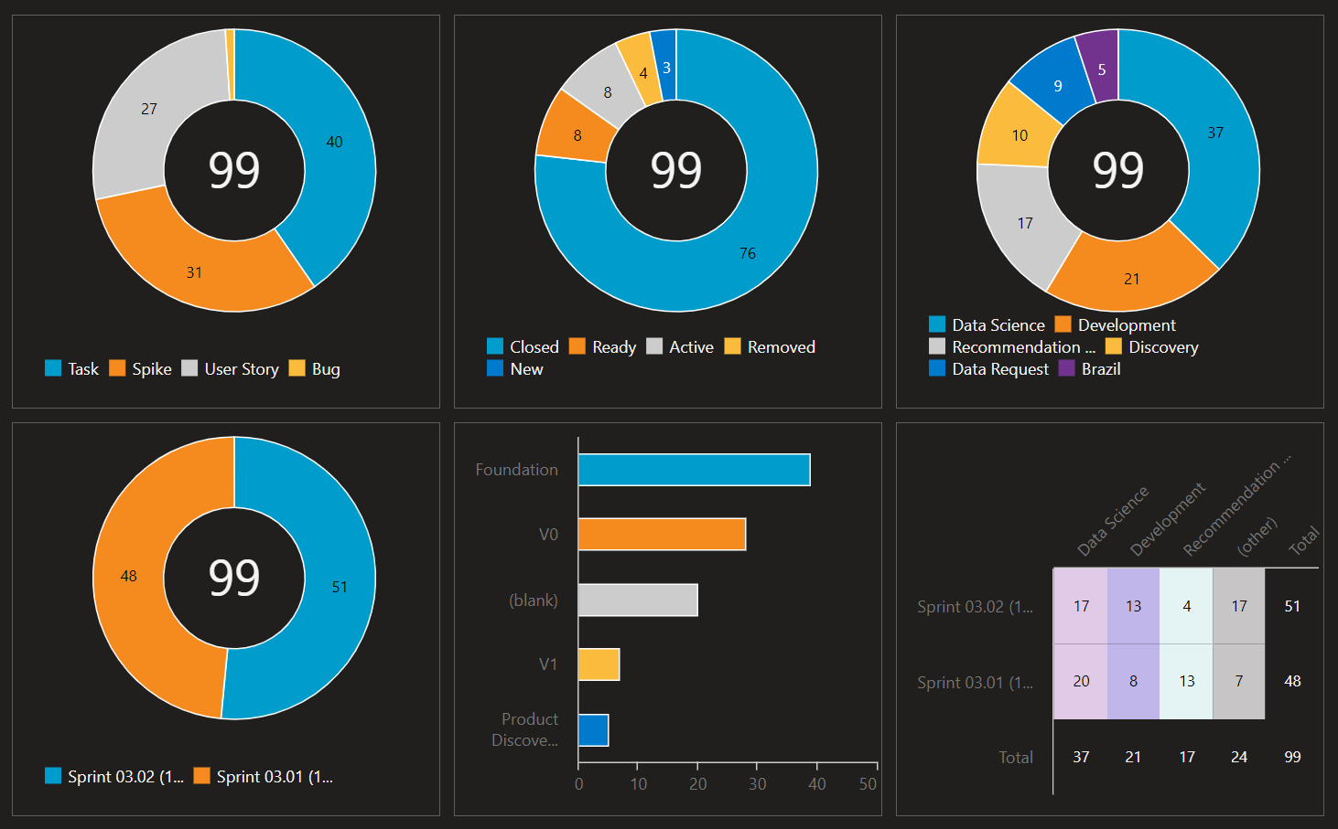
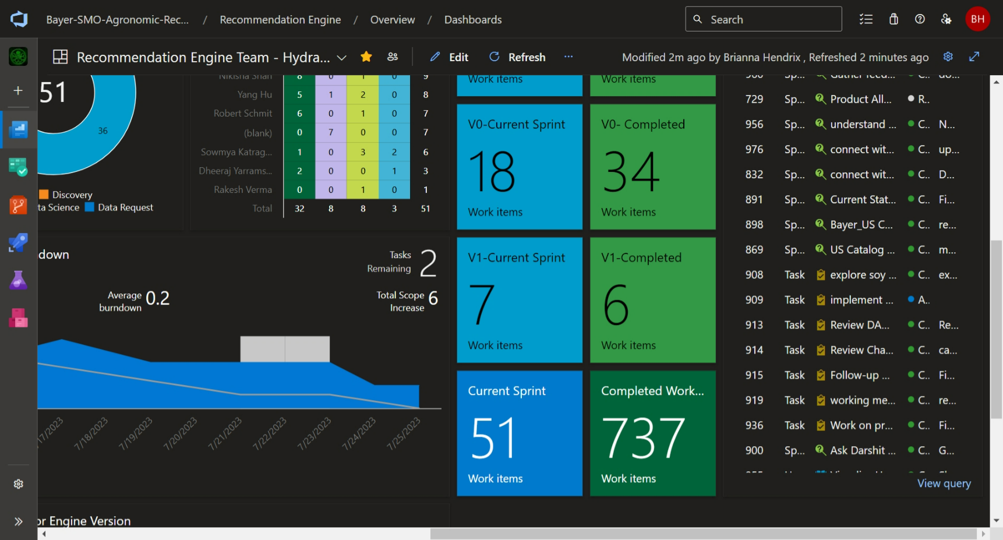
Continental – Completed work items

Slide 6
Continental • KT LATAM (mural.co)

